Slide 1
Using JS libraries in Your Webpage
Mr Mack 2022

Slide 2

What's a JS library?
There are a billion webpages, and many of them are interactive in some way - in fact, many of them are interactive in the same ways. How many websites have you seen that use a slideshow? I've seen hundreds, myself!
For example, here's one from National Geographic:

Slide 3

What's a JS library?
Here's one from Instagram:

Slide 4

What's a JS library?
One more, from The Onion:

Slide 5
What's a JS library?
Now, it's possible that every one of those web developers wrote their own JavaScript code to make a slideshow, but a lot of them probably re-used the same code. As programmers, we should re-use existing code when we can, so that we don't waste our time writing code that another programmer has already written.
In JavaScript, the way we do that is by using a library. A library is a JavaScript file that contains a bunch of functions, and those functions accomplish some useful task for your webpage.

Slide 6
What's a JS library?
How do we know what functions we can use? We could look at the JavaScript file, if it's short, or better, we could look at the documentation. Most libraries have documentation with a list of available functions or a real-world example.
For example, here's a snippet of the documentation for Galleria, a popular JS library for making slideshows:

Slide 7
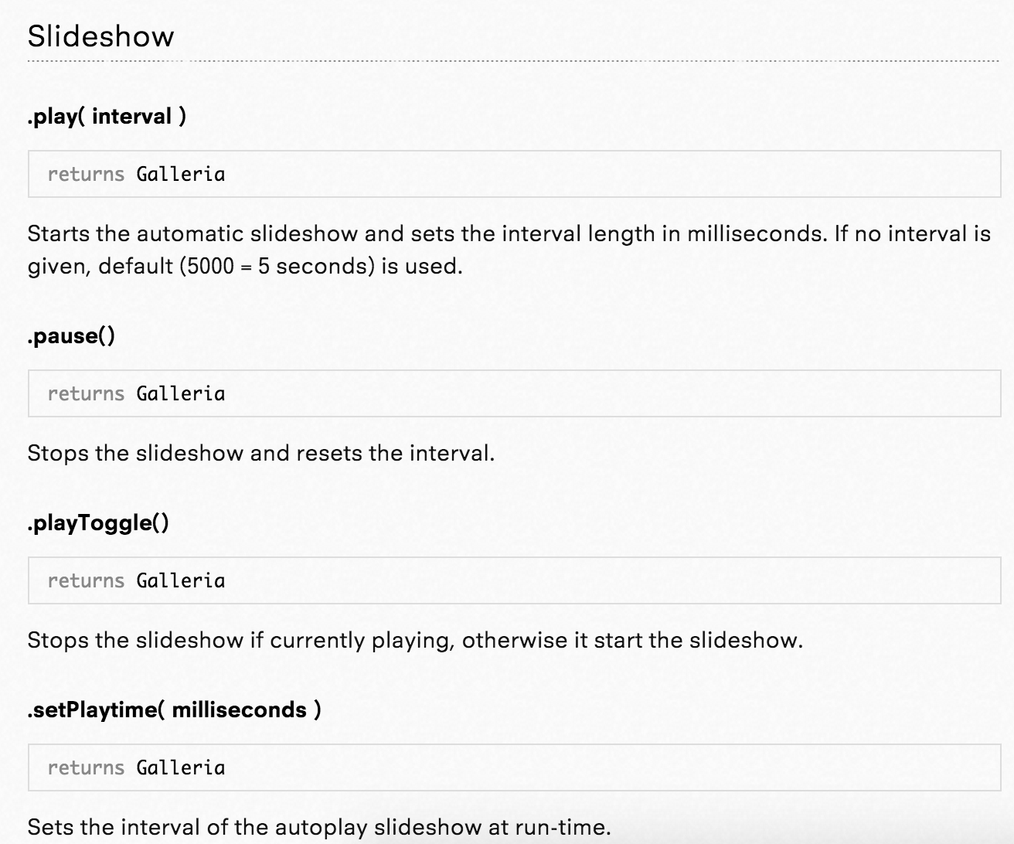
Notes:
When a programmer creates a JS library and puts it out into the world, they're purposefully deciding to share it with the world - so that often means they put in the effort to come up with great documentation and examples. Perhaps one day you will decide to create a library of some functionality that you find really useful and share it with the world.
But first, how do you actually use a library? I'll show you that next!

Slide 8
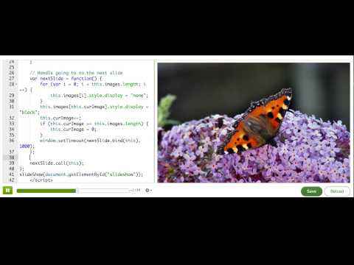
Using a JS library: Slideshow library

Slide 9
Where are JS libraries hosted?
hen we included the slideshow JS library in our webpage in the previous talk-through, we typed this URL:
https://cdn.jsdelivr.net/gh/pamelafox/ka-slideshow-example@master/slideshow.js
That URL is an absolute URL, which means that it includes the protocol and domain. When we include JS libraries in environment, we must use an absolute URL so that the environment knows the full path to the library.

Slide 10
Where are JS libraries hosted?
f you were working on a webpage on your own computer and you had all the files downloaded, then you could use a relative URL instead, like simply "slideshow.js" or "lib/slideshow.js" if it was inside a folder named "lib". When you're working locally, open your browser's network panel to make sure it found all the local resources like your JS files and CSS files. If the browser couldn't find a resource, you'll see a 404 and you can debug the URL and file location.
Now, back to this URL:
https://cdn.jsdelivr.net/gh/pamelafox/ka-slideshow-example@master/slideshow.js

Slide 11
Where are JS libraries hosted?
The protocol "https" means that it’s a secure URL. We only allow you to bring in secure resources in webpages, and that's a best practice in web development. Not all servers have HTTPS enabled yet, however, so you may sometimes have to start URLs with "http" in your projects.
The server "cdn.jsdelivr.net" is an example of a content delivery network (CDN). CDNs are optimized for serving static files like JS libraries and serving them very quickly. There are a few big CDNs that host multiple JS libraries (like Google's CDN and cdnjs), and there are some libraries that have their own dedicated CDN.

Slide 12
Where are JS libraries hosted?
When you bring a JS library into your webpage from a CDN—or any server that's not your own—you should not trust that server. A malicious server could replace the JS library with code that stole your user's data and sent it somewhere, and you certainly don't want that to happen!
We use a security mechanism called CSP in our webpage environment to make sure that you can only bring in resources from servers we trust: bootstrapcdn.com, googleapis.com, jsdelivr.net, and cdnjs.com.
On your own websites, you'll need to make the decision whether to serve the JS library from your own server or include it from an external CDN. Most big websites decide to host libraries on their own server, because they can have more control and make optimizations like combine multiple libraries into a single JS file for better loading performance. It's up to you—just keep in mind everything we talked about here!

Slide 13
The world of JS libraries
There are thousands of JavaScript libraries that you could bring into your webpage, and many aspects of your webpage that they can help you with:
DOM manipulation
DOM Events
AJAX / Data retrieval
Effects & animation
HTML templating
Page layout
UI widgets
Graphics & charts
Data modeling
Routing & navigation
Accessibility
Multi-browser support
Mobile support

Slide 14
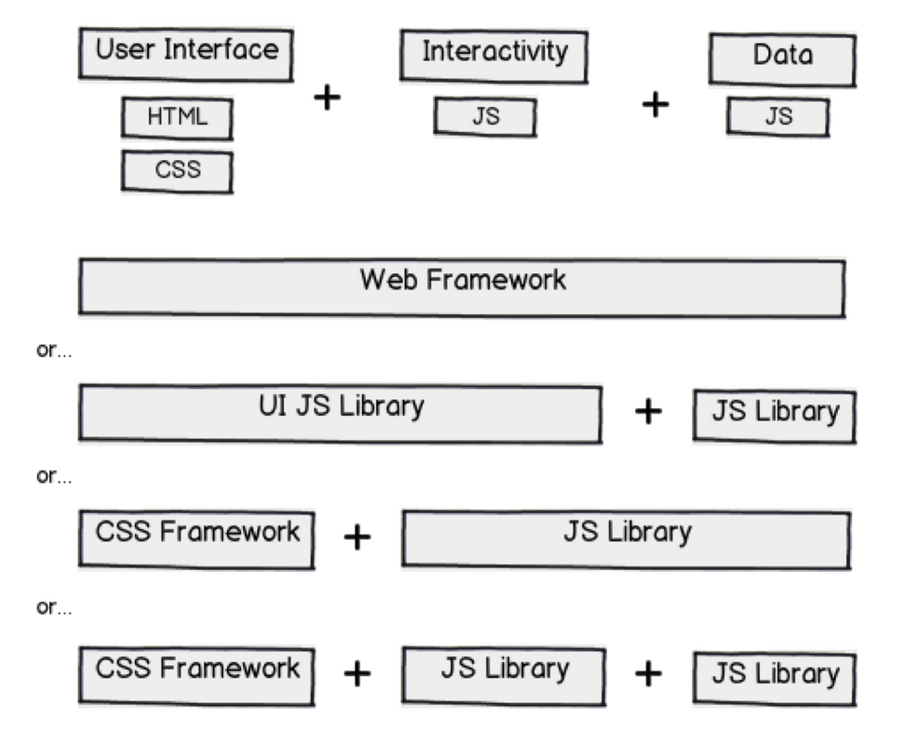
The world of JS libraries
Here's another way I like to think of it - a webpage is made up of the User Interface (HTML & CSS), Interactivity (JS + DOM), and Data (which we often bring in through JS). You can make your data-driven interactive UI without a library, or you can bring in different libraries to help out with different parts. Some libraries will do a lot, some will do just one part:
Notes:
One of the hardest parts of web development is deciding what libraries to use, because you'll often be writing code that builds on top of the libraries, and it's hard to change your decision later. There's no right answer - know your options, then make an educated guess.

Slide 15
Web frameworks
There are some libraries that "do it all" - everything from data retrieval to DOM manipulation to fancy UI widgets. If you use one of these frameworks, you'll typically be bringing a lot of JavaScript into your page, so you'll want to make sure you really need most of what the framework is offering you. For some developers, these frameworks do too much, and they find it better to use smaller libraries with more focused tasks.
jQuery UI
jQueryMobile
Dojo
Sencha
QooxDoo
Closure
KendoUI

Slide 16
CSS frameworks
A CSS library is a collection of CSS style rules, and documentation that shows you what HTML tags and classes to use. There are many popular CSS libraries that will make it easier for you to make a beautifully styled website. They sometimes include optional JavaScript widgets, but developers often choose to use other JS libraries with a CSS library.
Twitter Bootstrap
ZURB Foundation
Pure CSS
Topcoat
Skeleton

Slide 17
JS browser libraries
These are libraries that will make it easier for you to use browser functionality - like the DOM API, the window methods - the topics we discussed in this course. They often make it possible to accomplish the same thing in less code, and they'll take care of cross-browser bugs.
jQuery
ZeptoJS
MooTools
dollardom
QuoJS

Slide 18
JS app architecture libraries
These libraries help you with your web apps as they grow larger. Your code might be manageable now, at a few hundred lines of code, but once you get to thousands of lines of code, your code might become "spaghetti code" - an unmanageable mess. These libraries help you separate your "model" (data) from your "view" (presentation), and often use object-oriented programming principles to organize your code.
Facebook React + Facebook Flux
Backbone
AngularJS
EmberJS

Slide 19
Which JS library should you use?
There are a huge number of libraries out there, and for any given bit of functionality, there are likely multiple libraries that accomplish that bit of functionality. For example, there are so many date-picker libraries out there, that there are articles like "Top 15 jQuery DatePickers" to try to help developers pick from them.
But too many choices can turn into decision paralysis for us web developers. How do we know which one is best? What if we make the wrong choice?
There's often not a single "best choice" in web development. But there are often better choices than others, and thinking through the considerations below can help you make the better choice.
Notes:
Since a JS library is often used when developing a user-facing product, these considerations should satisfy two audiences: the developers that must code and maintain the code that uses the library (like you!), and the users that will interact with it.

Slide 20
Will it be a good developer experience?
Well documented: It should be easy to find a reference of function signatures, demos of actual usage, and a more narrative how-to-use guide. If a library has no documentation, it's usually a sign that they are not the most developer-friendly.
Flexible: The demos in the documentation might look great - but might want to use a library in a slightly or completely different way than what the demos show. Look for signs of flexibility - Is it easy to send in configuration options? Is there a documented plugin architecture? Does it trigger many events that you could hook your code into?
Actively maintained: Browsers change frequently. Libraries that once worked can suddenly stop working, because they relied on some quirk of the browser that changed. This is specially true of HTML5 shims and polyfills, because browsers are frequently releasing new versions with evolving implementations of the HTML5 elements. You can figure out how recently the library was updated by checking the date in their changelog. If there's no changelog and the library is hosted in an open source repository like Github, you can check the date of the last commit.

Slide 21
Will it be a good developer experience?
Future thinking: If you're looking for an HTML5 "shim", prefer a "polyfill" - a shim that mimics the API. That way, theoretically, when all your users were using browsers that supported the technology, you'd be able to stop using the library entirely, with no change to your code at all. For example, if you're using a library to use video in your webpage, use a polyfill that will let you use the HTML5 video tag, and it will replace it with a fallback technology like Flash in older browsers.
Tested: All good libraries should include tests that make sure their functionality works as expected. When a library is tested, then we can have confidence there will be some degree of backwards compatibility in new versions of the library.

Slide 22
Will it be a good developer experience?
Clean code: We could treat open-source libraries as black boxes, and refuse to look inside of them, but sometimes, you may need to dig inside of the library code to debug an issue or add a new bit of functionality. Take a quick look at the code and see how easy it is to read, and if it has any red flags, like big chunks of commented-out lines of code.
Responsive community: You will have questions. You will encounter bugs. Ideally, you'll be able to figure them out with developers, whether that's the maintainers or users.

Slide 23
Will it be a good user experience?
If the JS library does not create a UI component, then only the first few of these matter.
File size: How much will it contribute to how much JS your users have to download? For context, jQuery gzipped and minified is 18k and Select2 is 7K.
Performance: Besides size, other aspects of a JS library can affect its performance, like if it does heavy DOM manipulation, graphics rendering, computation, synchronous storage calls, etc. Look for promises of great performance on the documentation, and of course, try it out yourself.

Slide 24
Will it be a good user experience?
Browser support: Check that it supports all your desired browsers. Many libraries these days purposefully don't support older browsers (which your webpage may need to support), because they're designed to be lightweight and only for mobile browsers.
Accessibility: Many libraries for UI components look great, but they are not accessible (they do not work well for users with visual disabilities). For a quick check, you can run WAVE on the library's demos page.
Responsive: If your users will ever use the UI component from a library on a mobile browser, then it should work well for them there. Are the buttons big enough? Does it use touch events? Does it scale to small screen sizes?

Slide 25
Will it be a good user experience?
If you've considered all that criteria, and still can't decide between a handful of libraries, then you might try the call-a-friend approach: ask colleagues or developer friends what library they use. You might just find a crowd favorite.
Remember: there isn't one right answer, there isn't one best choice. Also, you don't have to comprehensively review every JS library you are thinking about using, especially if you're working on projects for your own. You can just pick a library and see what you like about it while you use it. You'll start to build a list in your head of your favorite libraries to use, and your own criteria for libraries, and that will help you in your future decisions.

